Slide 1

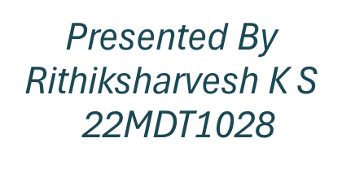
Water Quality Prediction Using
Machine Learning
Under The Guidance Of DR.Umamaheswari S

Slide 2

INTERNSHIP

Slide 3
OVERVIEW:
ABSTRACT
INTRODUCTION
LITERATURE REVIEW
AIM
DATASET DESCRIPTION
WORKING METHODOLOGY
BEST MODEL
SAMPLE REPORT
WQI INDEX PREDICTION
WATER USEABLE PREDICTION
REFERENCES
CONCLUSION

Slide 4
ABSTRACT:
Problem Statement: The Conventional methods for monitoring water quality suffer from several drawbacks such as time-consuming processes, limited scope ,need for manual intervention and struggles to adapt to changing conditions and increasing data volume.
Objective: To Enhance water quality monitoring model using machine learning to predict parameters like dissolved oxygen, pH, turbidity, and chemical concentrations, focusing on a robust classification model for assessing water quality satisfaction.
Workflow: Begin with in-depth Exploratory Data Analysis (EDA), followed by data cleaning, preprocessing, and Feature Engineering, including graph-based approaches. Apply diverse machine learning algorithms (SVM, Decision Trees, Random Forests, FNN, XGBoost, AdaBoost), selecting the top-performing model for deployment.

Slide 5
INTRODUCTION:
Recently Bangalore is facing significant water problems that are directly impacting water quality and usability. These issues include water scarcity, pollution from industrial and domestic sources, inadequate infrastructure for water treatment and distribution, and unsustainable groundwater extraction. These challenges collectively contribute to the deterioration of water quality, making it imperative to address these issues comprehensively to ensure access to clean and safe water for all residents of Bangalore.
This prediction is to provide early warnings or insights into potential water quality issues. These information can be used by environmental agencies, water resource managers.

Slide 6
LITERATURE REVIEW:
No | Paper Name | Author /Year | Description | Approach
1. | Design and Implementation of a Full-Time Artificial Intelligence of Things-Based Water Quality Inspection and Prediction System for Intelligent Aquaculture. | Wu-Chih Hu et al. (2024) | Aquaculture's water quality inspection by proposing an AIoT-based system employing an SRU model for 24/7 sensing, prediction, and management. | AIoT, Simple Recurrent Unit
2. | Nexus of Water Quality prediction | C. Manoj et al. (2022) | Rising water pollution concerns by employing artificial neural network models,to predict water quality indexing and categorization based on seven water quality factors. | LSTM, NARNET
3. | Calculation of Water Quality Index and Its Use for Water Quality Assessment in Lake Sevan | Zhukova et al. (2023) | The article discusses using the Delphi expert panel method to assess water quality in a high-mountain lake with variable levels. They developed the Lake Sevan water quality index (SWQI) based on seven characteristics | Delphi panel -method
4. | Evaluation of the surface water quality using global water quality index (WQI) models: perspective of river water pollution | Khan et al. (2023) | The study assesses Jamuna River water quality using six global WQIs, highlighting exceeding standard values and the need for proactive monitoring to address declining quality due to human activities. | Manual formulas with global water quality index

Slide 7
LITERATURE REVIEW:
5. | Machine learning approach towards explaining water quality dynamics in an urbanised river. | B. Beck et al. (2022) | The study analyses high-frequency data from the River Chess using boosted trees to understand water quality dynamics and the impact of human-induced drivers like Wastewater Treatment Works outflows on river ecosystems and machine learning techniques in untangling key drivers of water quality. | (GAM) , boosted trees.
6. | Water Quality Prediction Using Machine Learning Techniques. | M. Marri et al. (2023) | Water quality assessment for human health, agriculture, and the environment, proposing the use of machine learning algorithms to predict water quality based on various parameters and classify water as safe or unsafe for domestic purposes. | KNN, SVM, DT, RF
7. | Use of Machine Learning for Realtime Water Quality Prediction. | S. O. Ooko et al. (2023) | This study explores supervised learning models for predicting water quality, addressing the limitations of traditional methods, offering potential for real-time water quality assessment to mitigate related diseases and fatalities. | ANN, LR, KNN, RF
8. | An advanced deep learning model for predicting water quality index | M. Mohammad Ehteram et al. (2024) | The study develops a hybrid model, CNN-CRNN-M5T, for WQI prediction using CNN, Clockwork RNN, and M5 Tree models, finding NH-NL and PH to be significant variables impacting WQI in a Malaysian basin. | RNN, CNN
9. | Deep learning for water quality | Wei Zhi et al. (2024) | The review emphasizes the potential of deep learning methods in addressing data scarcity and improving water quality predictions, highlighting their strengths relative to traditional approaches and their emerging role in water-quality sciences. | (PGDL) (DM).

Slide 8

AIM :
This project aims to pioneer a best machine learning model to predict WQI index and Water useability . By leveraging the power of data-driven models, we aim to develop a robust and dependable prediction system capable of estimating vital water quality parameters such as dissolved oxygen (DO), pH, turbidity, and chemical concentrations.

Slide 9
DATASET DESCRIPTION :
DETAILS- Consists of 8276 Rows and 10 parameters
PARAMETERS -pH, Hardness, Total dissolved solids, Chloramines , Sulphate, Conductivity, Total organic carbon, Trihalomethanes, Turbidity, Potability
WATER USEABILITY
DATASET
DETAILS- Consists of 270 Rows and 10 parameters
PARAMETERS –Temperature, Dissolved Oxygen,pH, Bio-Chemical Oxygen Demand, Faecal Streptococci , Faecal Coliform, Total Coliform Conductivity, Wqi
WQI
DATASET

Slide 10
WORKING METHODOLOGY:
Water Quality Data
Exploratory Data Analysis
Data Cleaning and Transformation
Feature Engineering
Best Model
Model Comparison & Performance Evaluation
Model Building
Train and Test data
WATER USEABILITY PREDICTION
WQI PREDICTION

Slide 11
ALGORITHMS :
FNN
CNN
RANDOM FOREST
SVM
XGBOOST

Slide 12
Exploratory Data Analysis:
Helps in understanding the underlying patterns, relationships, and anomalies present in the different parameters of the water.
Calculate correlation coefficients or create correlation matrices to identify strong positive or negative correlations.
Feature visualizations
Gain valuable insights.

Slide 13
2. Data Cleaning:
Ensures that the data used for analysis and modeling is accurate, consistent, and reliable.
Handling Missing Value
Removing Duplicate Records
Dealing with Outliers
Handling Imbalanced Data

Slide 14
3. Data Transformation:
Involves manipulating the data.
Feature Scaling : To normalize the range of independent variable using Min-max normalization or Z- score standardization.
Encoding categorical variables

Slide 15
4. Data Visualization:
Gain insights
Identify patterns
Useful for identifying outliers.
Exploring the relationships and dependencies between multiple water quality parameters.
These visualizations help identify the range, shape, and skewness of the data distribution.

Slide 16
5. Feature Engineering:
It involves creating new features or transforming existing ones to extract meaningful information.
This can include deriving additional variables such as water quality indices or ratios based on the existing parameters.
Feature engineering can help capture important relationships and patterns that may not be evident in the raw data.

Slide 17
6. Training & Splitting Data
Before building prediction models, it is crucial to split the data into training, validation, and testing sets. This ensures that the model is trained on a portion of the data and tested on an independent set to assess its generalization ability.
The typical split is around 70-80% for training and 20-30% for testing.

Slide 18
7. Model Building
FNN : Artificial neural network that consists of a series of layers of nodes, with each layer connected to the next layer in a forward direction, with no backward connections..
CNN : . CNNs work by extracting features from images and then learning complex relationships between these features and the output classes.
Random Forest: An ensemble model that combines multiple decision trees to make predictions by averaging their results.
SVM: A model that separates data into different classes by finding the optimal hyperplane that maximally separates the classes in a high-dimensional space.
XGBoost: XGBoost is an optimized implementation of gradient boosting that offers high prediction accuracy and efficiency.

Slide 19
8. Model Evaluation
Accuracy The percentage of predictions that are accurate is known as accuracy.
Precision is the proportion of positive predictions that are actually positive.
F1-score is a harmonic mean of precision and recall, and is often used as a more balanced measure of performance than accuracy.
Recall is the proportion of all positive cases that are correctly predicted.

Slide 20
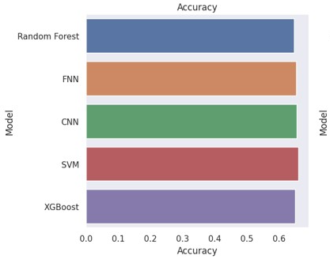
BEST MODEL :
Using random forest model for predicting :
WATER USEABILITY
WQI INDEX
 | Model | Accuracy | Precision | F1_Score | Recall
 | Random Forest | 0.660089 | 0.669837 | 0.554359 | 0.660089
 | SVM | 0.654450 | 0.644118 | 0.544017 | 0.654450
 | FNN | 0.653242 | 0.620584 | 0.568404 | 0.653242
 | CNN | 0.649215 | 0.609377 | 0.569039 | 0.649215
 | XGBoost | 0.646798 | 0.418348 | 0.508074 | 0.646798

Slide 21
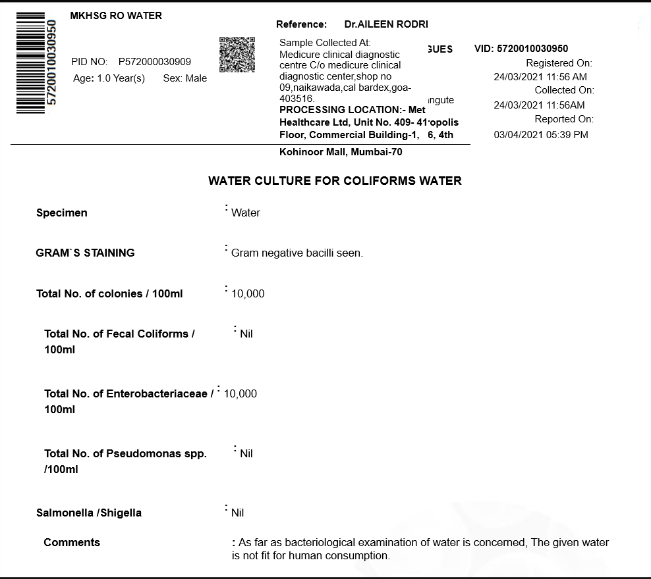
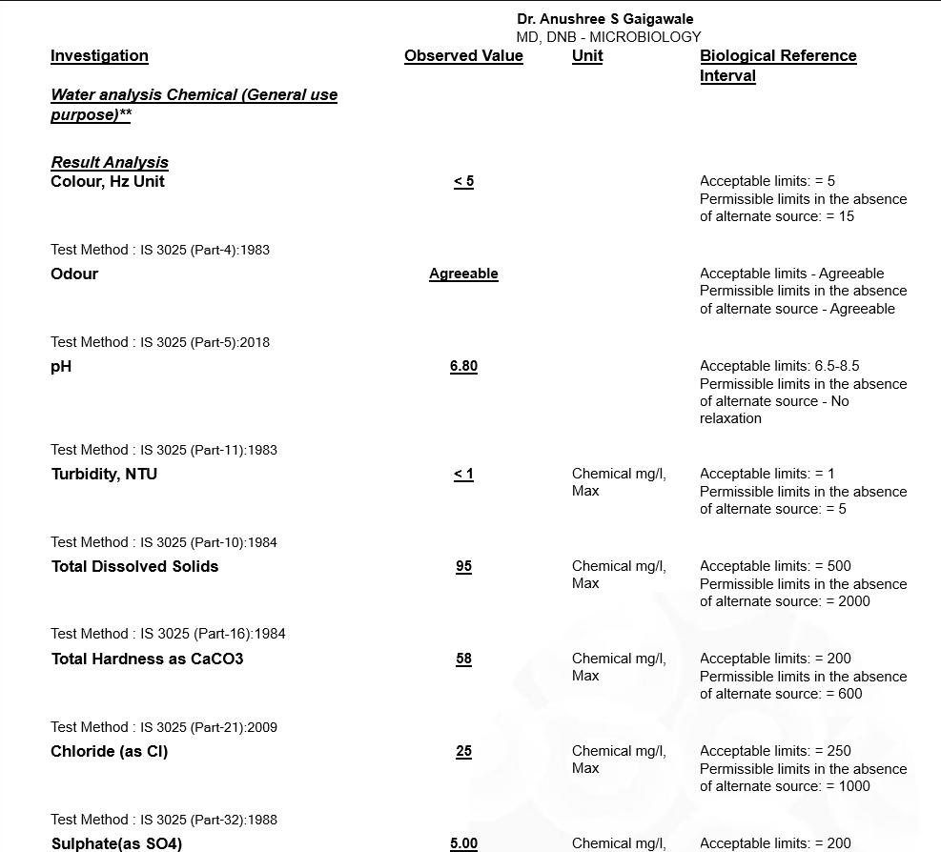
SAMPLE WATER QUALITY REPORT :
https://mydiagnostics.in/products/water-testing-quality-analysis-at-home-in-chennai?variant=39876320329827
Collected From :MY DIAGONITICS

Slide 22
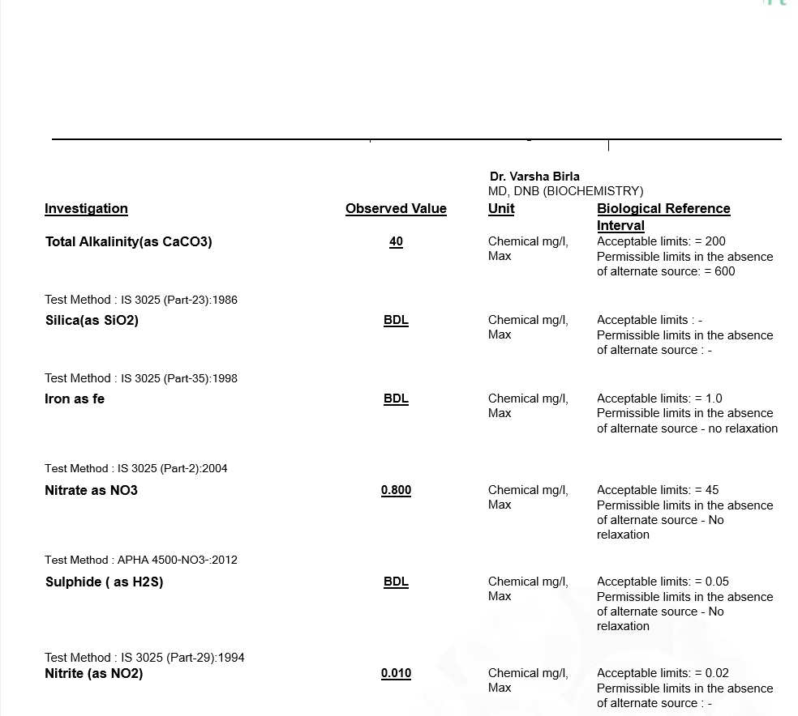
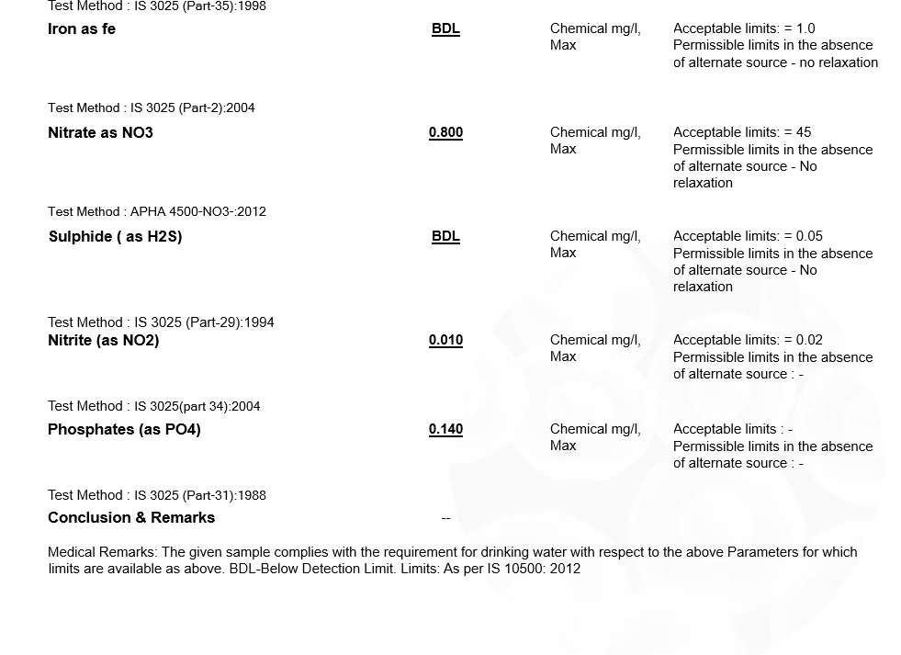
SAMPLE WATER QUALITY REPORT :
https://mydiagnostics.in/products/water-testing-quality-analysis-at-home-in-chennai?variant=39876320329827
Collected From :MY DIAGONITICS

Slide 23
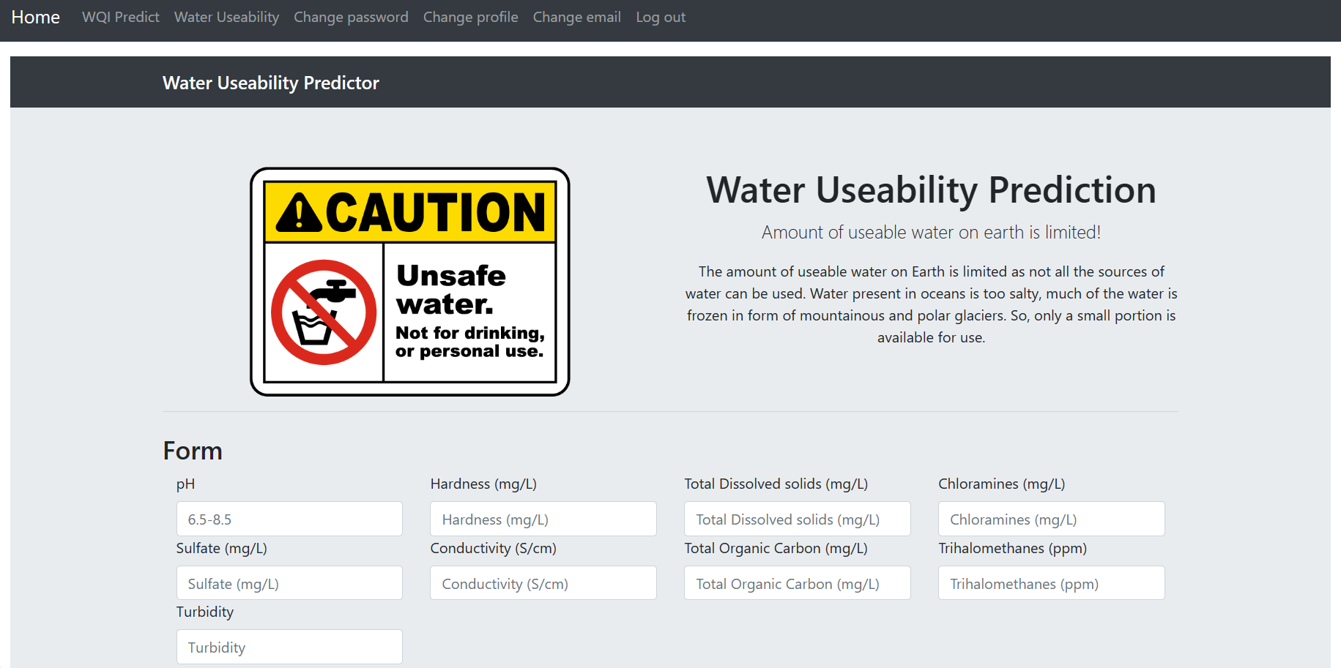
Water Usability prediction

Slide 24
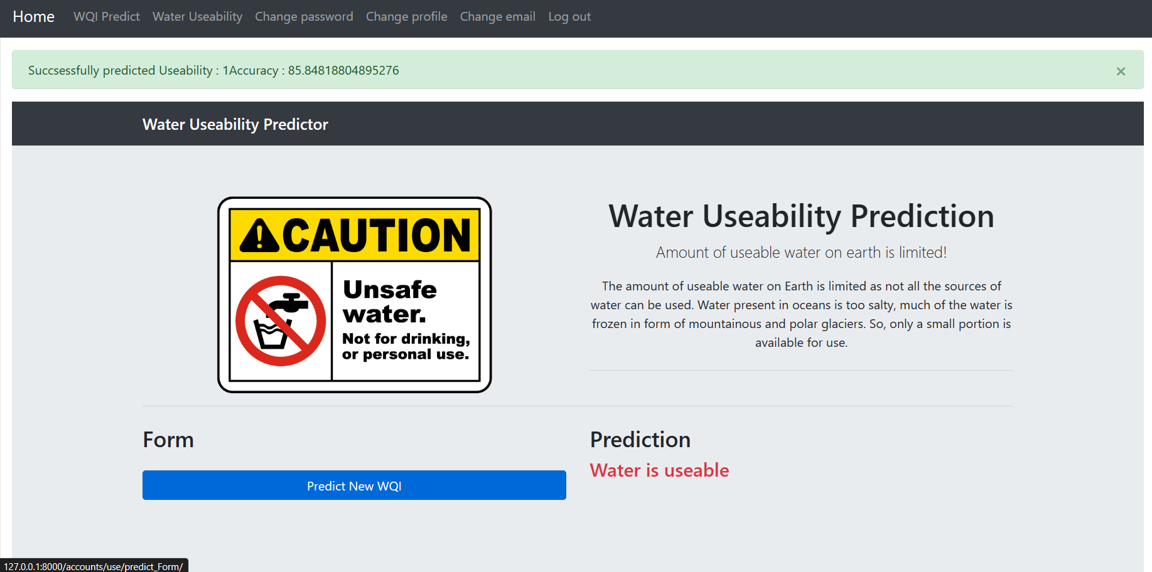
Water Usability prediction

Slide 25
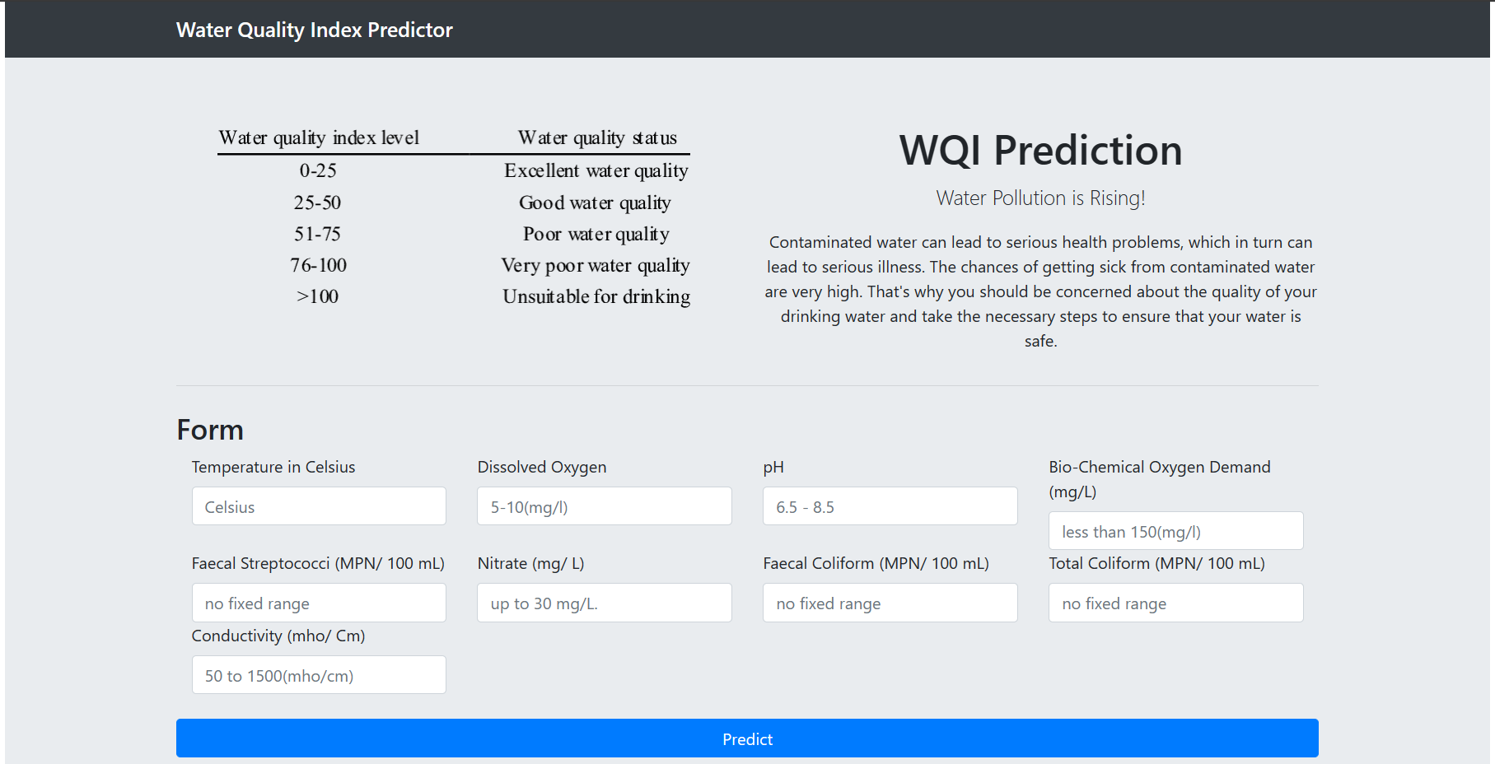
WQI Prediction

Slide 26
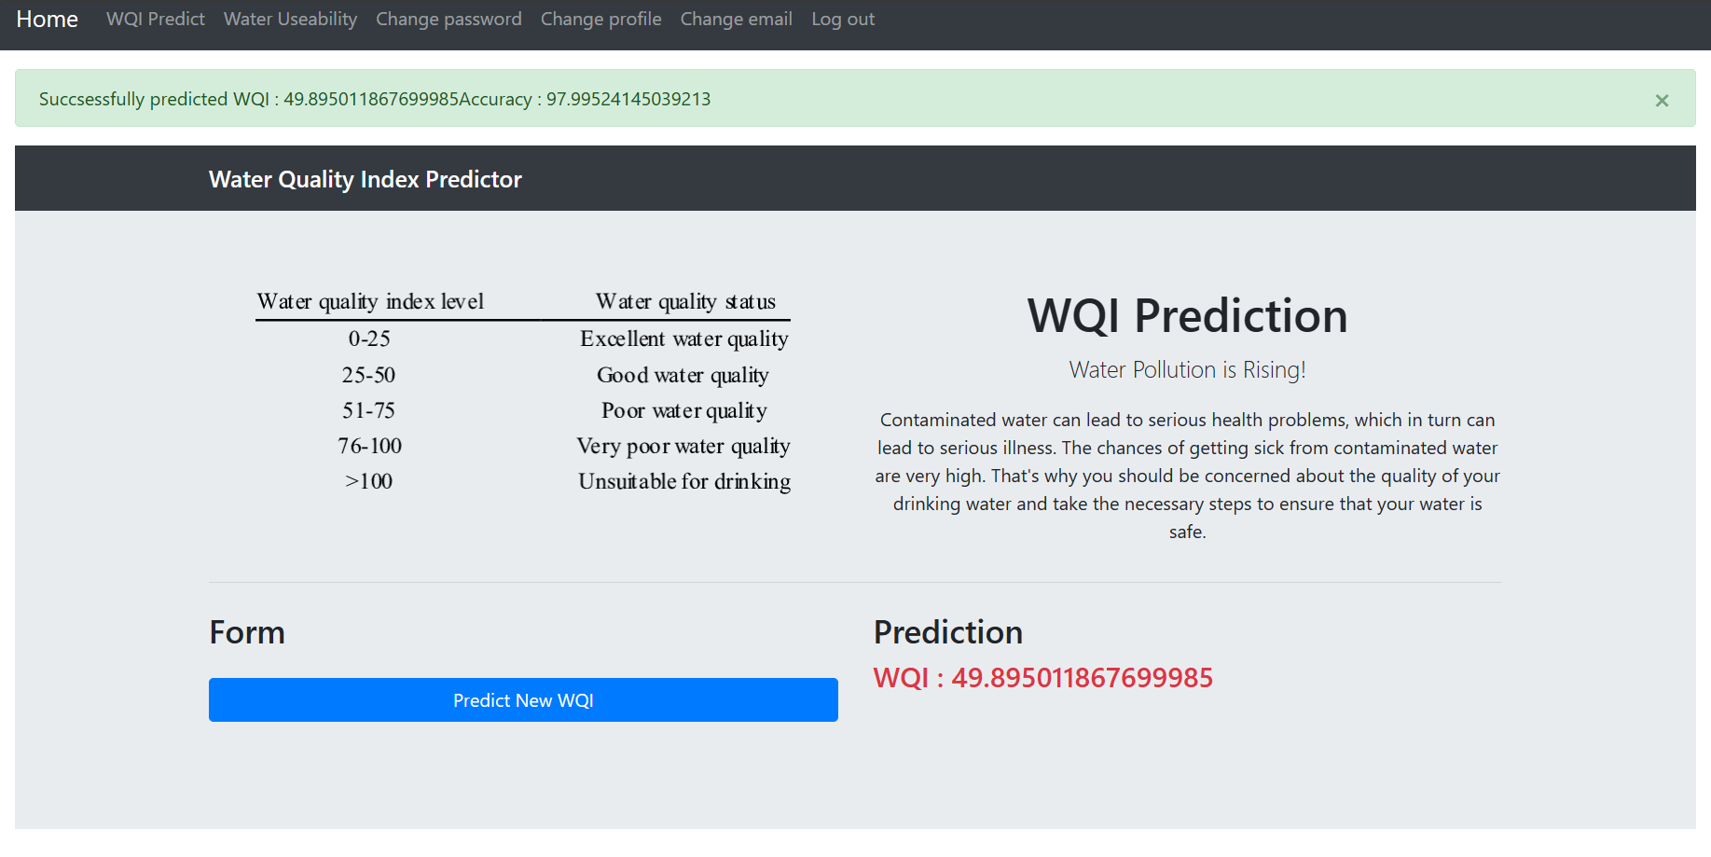
WQI Prediction

Slide 27
References
W. -C. Hu, L. -B. Chen, B. -H. Wang, G. -W. Li and X. -R. Huang, "Design and Implementation of a Full-Time Artificial Intelligence of Things-Based Water Quality Inspection and Prediction System for Intelligent Aquaculture," in IEEE Sensors Journal, vol. 24, no. 3, pp. 3811-3821, 1 Feb.1, 2024, doi: 10.1109/JSEN.2023.3340295.
T. Tejaswi, C. Manoj, P. Venkata Daivakeshwar Naidu, T. Santhosh, P. Venkata Sai Akhil and V. Ganesan, "Nexus of Water Quality prediction by ANN," 2022 International Conference on Innovative Computing, Intelligent Communication and Smart Electrical Systems (ICSES), Chennai, India, 2022, pp. 1-5, doi: 10.1109/ICSES55317.2022.9914054.
Babayan, G.H., Zhukova, A.A. & Veres, Y.K. Calculation of Water Quality Index and Its Use for Water Quality Assessment in Lake Sevan. Water Resour 50, 894–900 (2023).
Khan, M.H.R.B., Ahsan, A., Imteaz, M. et al. Evaluation of the surface water quality using global water quality index (WQI) models: perspective of river water pollution. Sci Rep 13, 20454 (2023).

Slide 28
References
B. Aslam, Schäfer, B., Beck, C., Rhys, H. et al. Machine learning approach towards explaining water quality dynamics in an urbanised river. Sci Rep 12, 12346 (2022).
N. S. Pagadala, M. Marri, A. Myla, B. Abburi and K. S. Ramtej, "Water Quality Prediction Using Machine Learning Techniques," 2023 10th International Conference on Signal Processing and Integrated Networks (SPIN), Noida, India, 2023, pp. 358-362, doi: 10.1109/SPIN57001.2023.10117415.
S. O. Ooko, E. K. Pamela and G. Kwagalakwe, "Use of Machine Learning for Realtime Water Quality Prediction," 2023 IEEE AFRICON, Nairobi, Kenya, 2023, pp. 1-6, doi: 10.1109/AFRICON55910.2023.10293701.
Ehteram M, Ahmed AN, Sherif M, El-Shafie A. An advanced deep learning model for predicting water quality index. Ecological Indicators. 2024 Mar 1;160:111806.
Zhi, W., Appling, A.P., Golden, H.E. et al. Deep learning for water quality. Nat Water 2, 228–241 (2024).

Slide 29
Conclusion:
Experience with using different machine learning models for predicting WQI and water usability, Random Forest emerges as the best model among FNN, CNN, SVM, and XGBoost. Its effectiveness in accurately predicting WQI index and water usability showcases its robustness and suitability for such tasks. This conclusion highlights Random Forest as a reliable choice for applications related to water quality assessment and prediction.

Slide 30
Thank You

